Slide 1
1 Corinthians 3:1-9 (NIV)
1Brothers, I could not address you as spiritual but as worldly--mere infants in Christ. 2 I gave you milk, not solid food, for you were not yet ready for it. Indeed, you are still not ready. 3 You are still worldly. For since there is jealousy and quarreling among you, are you not worldly? Are you not acting like mere men? 4 For when one says, "I follow Paul," and another, "I follow Apollos," are you not mere men? 5 What, after all, is Apollos? And what is Paul? Only servants, through whom you came to believe--as the Lord has assigned to each his task.

Slide 2
1 Corinthians 3:1-9 (NIV)
6 I planted the seed, Apollos watered it, but God made it grow. 7 So neither he who plants nor he who waters is anything, but only God, who makes things grow. 8 The man who plants and the man who waters have one purpose, and each will be rewarded according to his own labor. 9 For we are God's fellow workers; you are God's field, God's building.

Slide 3
cultivating complete church culture
POSITIVE LESSONS FROM ADDRESSING ISSUES IN THE CHURCH AT CORINTH

Slide 4
cultivating unity by putting Jesus first
1 CORINTHIANS 1:10-4:21

Slide 5
UNITY
CULTIVATING UNITY 1 CORINTHIANS 1:10-4:21

Slide 6
UNITY
UNIFORMITY
CONFORMITY
CULTIVATING UNITY 1 CORINTHIANS 1:10-4:21

Slide 7
cultivating unity in the church: 1 CORINTHIANS
UNITY
important
to Jesus
[JOHN 17:23a]

Slide 8
cultivating unity in the church: 1 CORINTHIANS
UNITY
integral
to witness
[JOHN 17:23b: ACTS 2:42-47]

Slide 9
cultivating unity in the church: 1 CORINTHIANS
UNITY
joy to
experience
[PSALM 133:1]

Slide 10
cultivating unity in the church: 1 CORINTHIANS
UNITY
a spiritual reality
requiring practice
[EPHESIANS 4:3]

Slide 11
cultivating unity in the church: 1 CORINTHIANS
DISUNITY
confronted four times in Paul’s letter to Corinth
[1:10-4:21; 6:1-11; 11:17-34; 12-14]

Slide 12
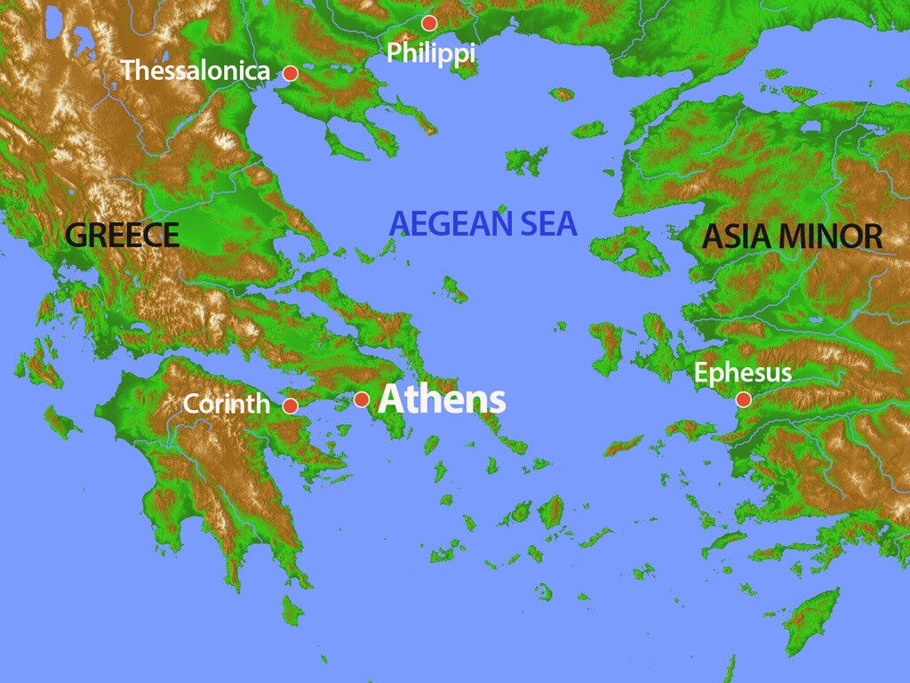
THE CITY OF CORINTH
Ancient Greek City-State
Major City in Romans times
Major traffic & trade point
Cosmopolitan population
cultivating unity - 1 CORINTHIANS 1:10-4:21

Slide 13
THE CHURCH IN CORINTH
Paul established it (Acts 18)
Paul taught there for 18 months (Acts 18-19)
Impacted by its cosmopolitan and religious culture
Impacted by having Gentiles & Jews together
Alive, but loaded with problems (See 1 Cor. 1:1-9)
cultivating unity - 1 CORINTHIANS 1:10-4:21

Slide 14
cultivating unity by putting Jesus first
1 CORINTHIANS 1:10-4:21

Slide 15
HOW PAUL DEALT WITH DISUNITY
APPEAL | be united | 1:10
PROBLEM | disunity (jealousy & quarrels | 1:11-12
SOLUTION | Focus on Christ | 1:13
SOLUTION | Only Christ saves | 1:14-2:15
PROBLEM | disunity (immaturity & worldliness) | 3:1-4
SOLUTION | people are just servants | 3:5-9
SOLUTION | Paul & Apollos are just servants | 3:10-4:21
APPEAL | imitate me | 4:16
Cultivating unity by putting Jesus first: 1 CORINTHIANS 1:10-4:21

Slide 16
cultivating unity in the church: 1 CORINTHIANS 1:13-17: 2:1-4; 3:10-14; 4:1--16
Follow positive
examples that
leaders set

Slide 17
cultivating unity in the church: 1 CORINTHIANS1:10-17
Don’t factionalise around leaders in a way that works against unity
ETHNIC ?
THEOLOGICAL ?
INTER-HOUSEHOLD?

Slide 18
cultivating unity in the church: 1 CORINTHIANS 1:10-17
Be wary of people who
want to take the spiritual
high-ground
Paul indicates that he didn’t think those claiming to ‘follow Christ’ were really doing that.

Slide 19
cultivating unity in the church: 1 CORINTHIANS 1:10-18-2:15
Remember that God saves by the foolish & weak cross, not by the wisdom (Gentiles) or power (Jews) of leaders

Slide 20
cultivating unity in the church: 1 CORINTHIANS 3:1-4
Factions and fighting are not a sign of wisdom and power but immaturity and worldliness
DISUNITY IS AN IMPEDIMENT TO WITNESS

Slide 21
cultivating unity in the church: 1 CORINTHIANS 3:5-23
Realise that leaders are only God’s servants.
It is GOD alone who accomplishes anything

Slide 22
cultivating unity in the church: 1 CORINTHIANS 4:6-7
Remember to be humble rather than proud because anything we are and have is received from God

Slide 23
cultivating unity in the church: 1 CORINTHIANS 4:1-13 & 16
Follow the example of
servant leaders
(like Paul and Apollos)

Slide 24
cultivating unity in the church: 1 CORINTHIANS 4:6-7
UNITY is a collective responsibility. Value it. Work for it. Preserve it by making Christ central. Follow leaders in their humility.

Slide 25
cultivating unity by putting Jesus first
1 CORINTHIANS 1:10-4:21

